Slide 1
My Book with No Pictures
Inspired by and based upon The Book With No Pictures by B.J. Novak, this activity allows a student to imagine their own personalized edition of the book. Created by Scott Mckay.

Slide 2
My Book with No Pictures
By: __________________________

Slide 3
My Book with No Pictures
By: __________________________

Slide 6
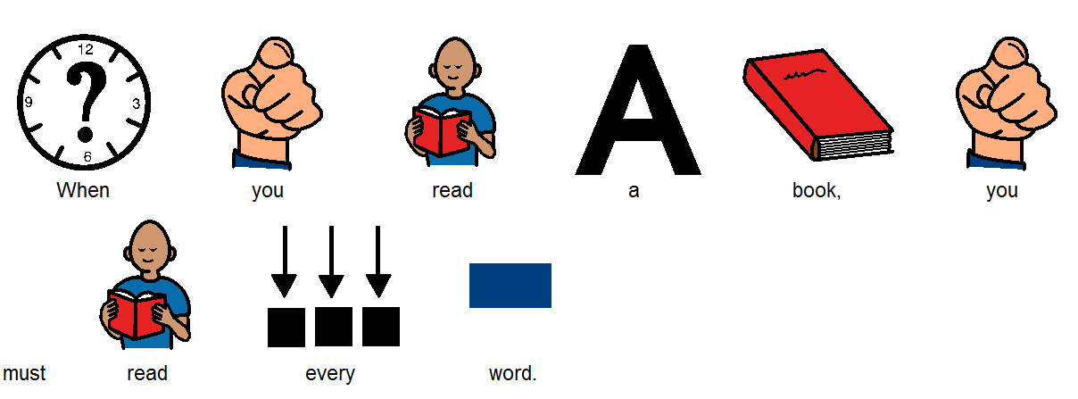

Slide 8
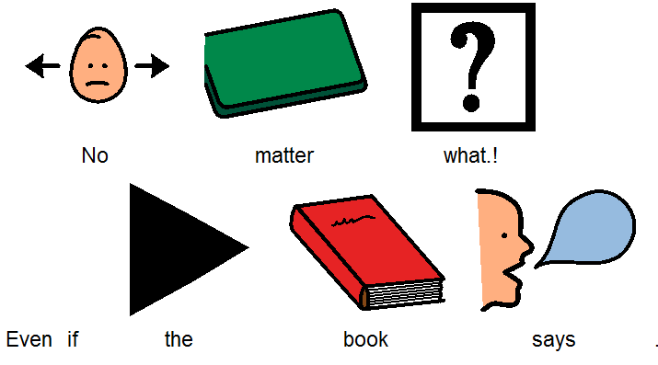

Slide 10
I didn’t want to say that.

Slide 11
I didn’t want to say that.

Slide 12
Really?

Slide 13
Really?

Slide 14
Oh my goodness.

Slide 15
Oh my goodness.

Slide 16
The End.

Slide 17
The End.

